Slide 1

Java course
-3-

Slide 2
3.Webserver and requests

Slide 3

What is a webserver?
At the most basic level, whenever a browser needs a file which is hosted on a web server, the browser requests the file via HTTP. When the request reaches the correct web server (hardware), the HTTP server (software) accepts request, finds the requested document (if it doesn't then a 404 response is returned), and sends it back to the browser, also through HTTP.

Slide 4
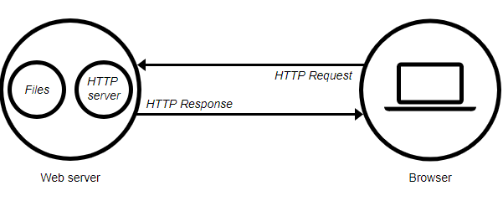
How a webserver works?

Slide 5
What are request?
HTTP defines a set of request methods to indicate the desired action to be performed for a given resource. Although they can also be nouns, these request methods are sometimes referred as HTTP verbs. Each of them implements a different semantic, but some common features are shared by a group of them

Slide 6
Request Types(common)
GET
The GET method requests a representation of the specified resource. Requests using GET should only retrieve data.
POST
The POST method is used to submit an entity to the specified resource, often causing a change in state or side effects on the server.

Slide 7
Request types(rare/unused)
HEAD
The HEAD method asks for a response identical to that of a GET request, but without the response body.
PUT
The PUT method replaces all current representations of the target resource with the request payload.
DELETE
The DELETE method deletes the specified resource.
CONNECT
The CONNECT method establishes a tunnel to the server identified by the target resource.
OPTIONS
The OPTIONS method is used to describe the communication options for the target resource.
TRACE
The TRACE method performs a message loop-back test along the path to the target resource.
PATCH
The PATCH method is used to apply partial modifications to a resource.

Slide 8
What is MAVEN
Maven is a tool that can now be used for building and managing any Java-based project.
Maven’s primary goal is to allow a developer to comprehend the complete state of a development effort in the shortest period of time. In order to attain this goal there are several areas of concern that Maven attempts to deal with:
Making the build process easy
Providing a uniform build system
Providing quality project information
Providing guidelines for best practices development
Allowing transparent migration to new features

Slide 9
Maven POM file
A Project Object Model or POM is the fundamental unit of work in Maven. It is an XML file that contains information about the project and configuration details used by Maven to build the project. It contains default values for most projects. Examples for this is the build directory, which is target; the source directory, which is src/main/java; the test source directory, which is src/test/java; and so on. When executing a task or goal, Maven looks for the POM in the current directory. It reads the POM, gets the needed configuration information, then executes the goal.

Slide 10
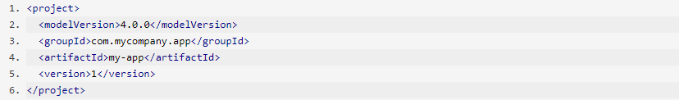
Configuring a POM file
The minimum requirement for a POM are the following:
-project root
-modelVersion - should be set to 4.0.0
-groupId - the id of the project's group.
-artifactId - the id of the artifact (project)
-version - the version of the artifact under the specified group

Slide 11
Configuring a POM file
Elements in the POM that are merged are the following:
-dependencies
-developers and contributors
-plugin lists (including reports)
-plugin executions with matching ids
-plugin configuration
-resources

Slide 12
Configuring a POM file
Elements in the POM that are merged are the following:
-dependencies
-developers and contributors
-plugin lists (including reports)
-plugin executions with matching ids
-plugin configuration
-resources
For more details please visit and READ :
https://maven.apache.org/guides/introduction/introduction-to-the-pom.html

Slide 13
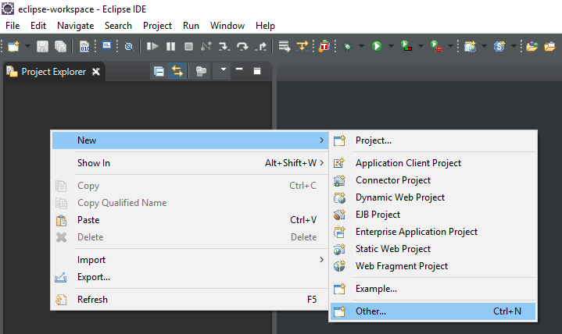
Enough talk, let`s code
Creating a new maven project in eclipse:
Project Explorer->New->Other

Slide 14
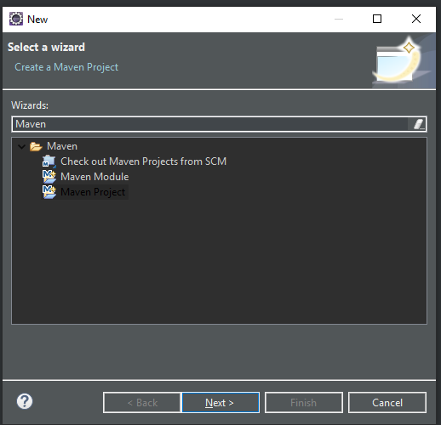
Search for Maven Project

Slide 15
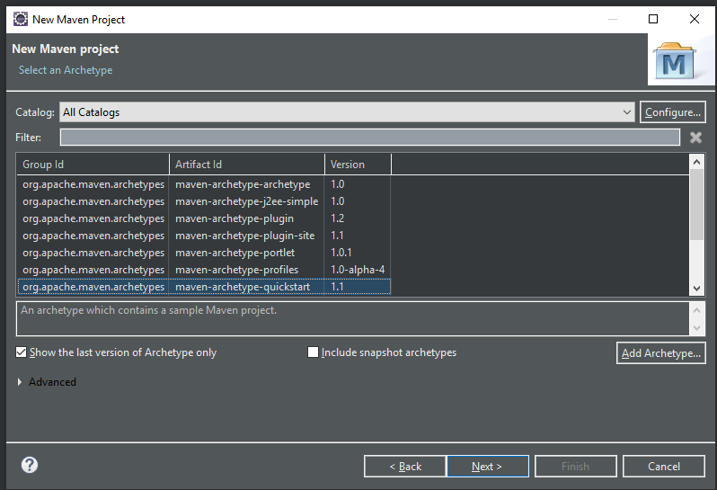
Select maven-archetype-quickstart

Slide 16
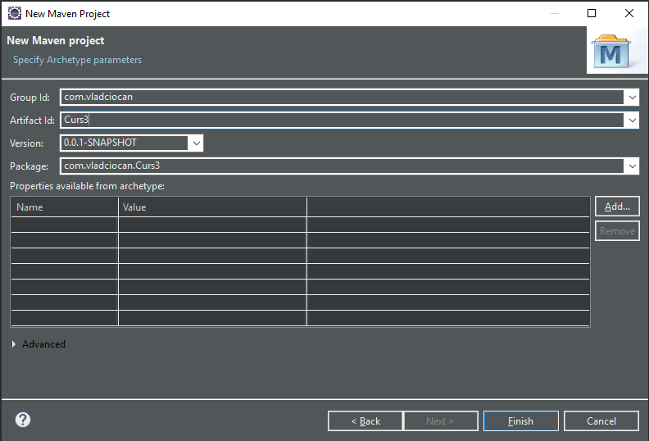
Group ID ->ro.<you`re name>
Artifact I-><name of project>
Click Finish

Slide 17
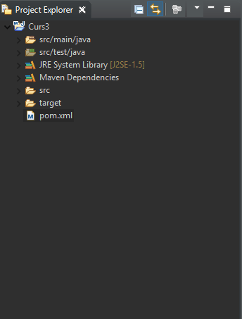
Observe project structure

Slide 18
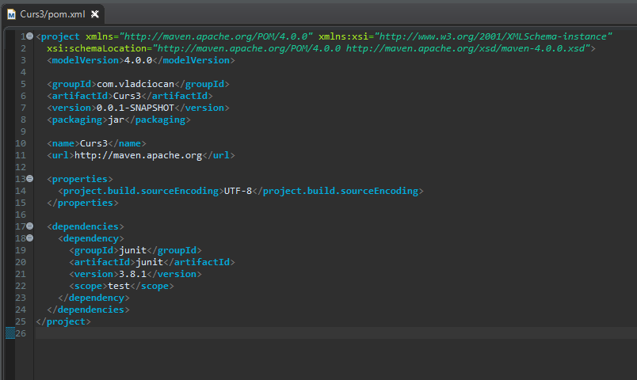
Open Pom to add Dependency

Slide 19
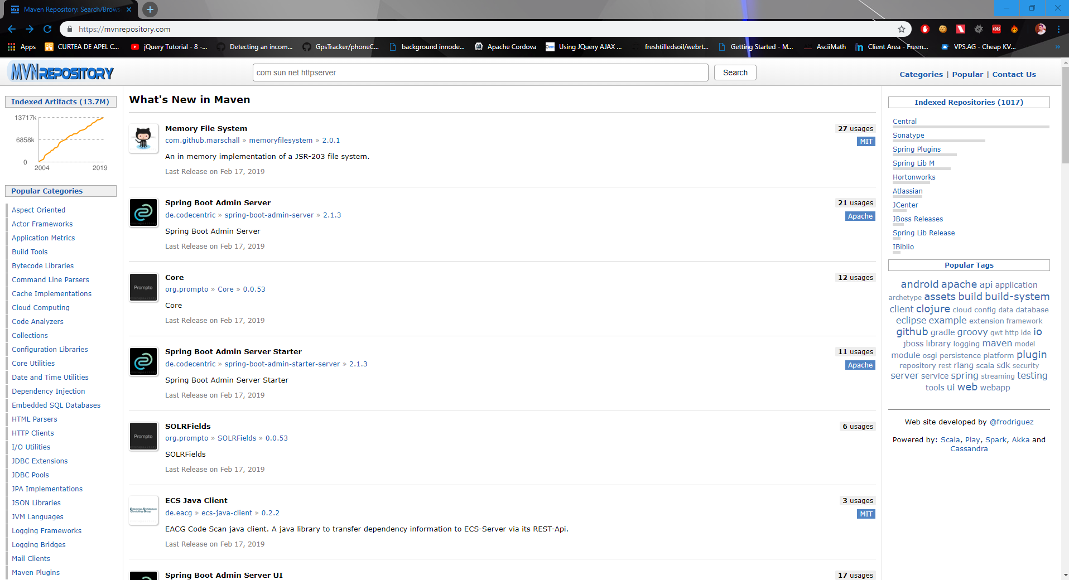
Search Maven Central for required dependecys
https://mvnrepository.com/

Slide 20
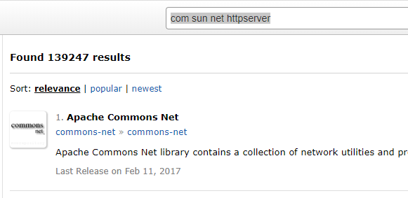
Search for :
“com sun net httpserver”

Slide 21
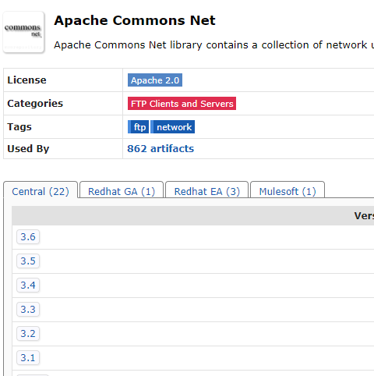
Select required version

Slide 22
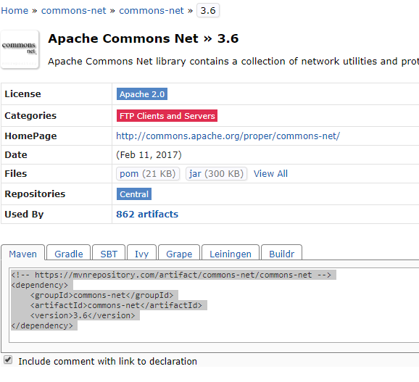
Copy script dependecy

Slide 23
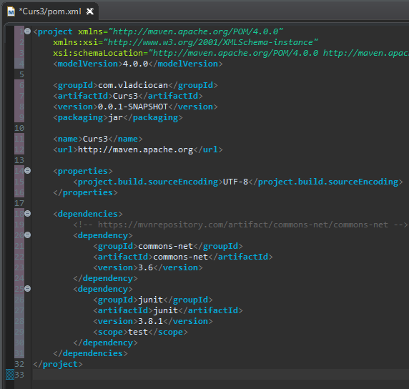
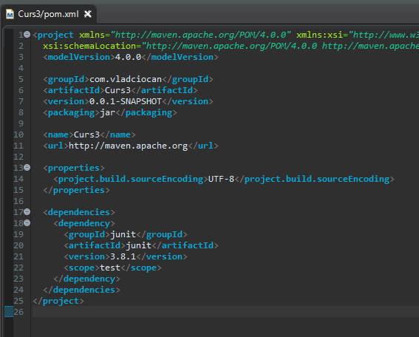
Paste dependency in POM

Slide 24
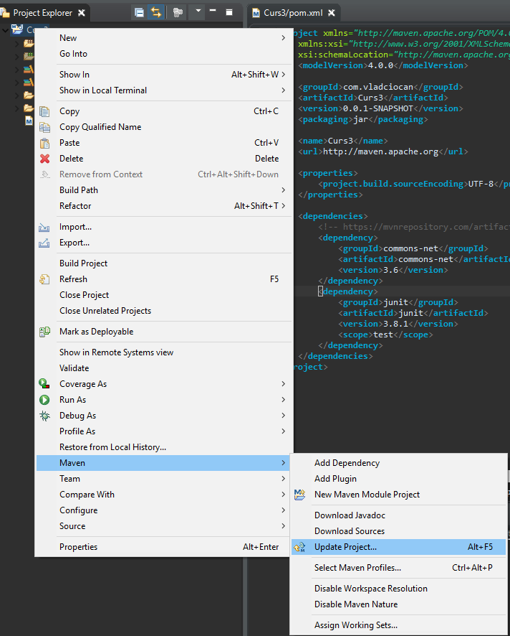
Save project and Update It

Slide 25
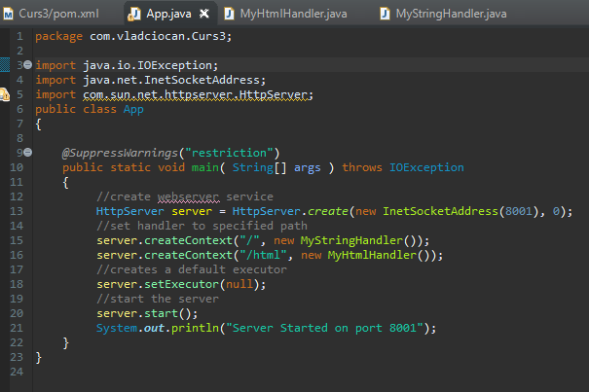
Add this code to main class:

Slide 26
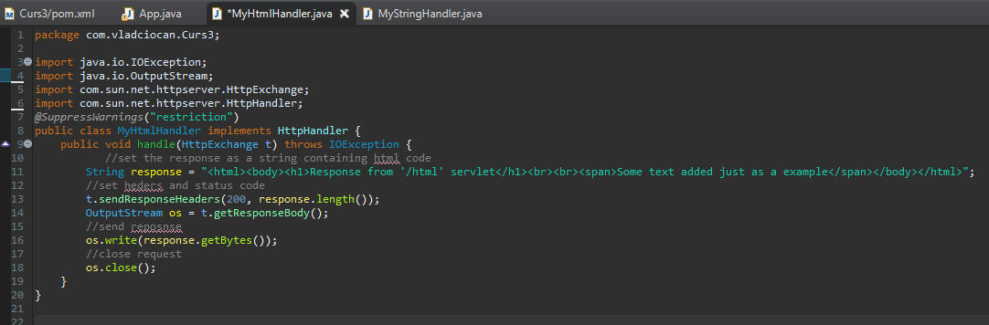
Create a MyHtmlHandler class

Slide 27
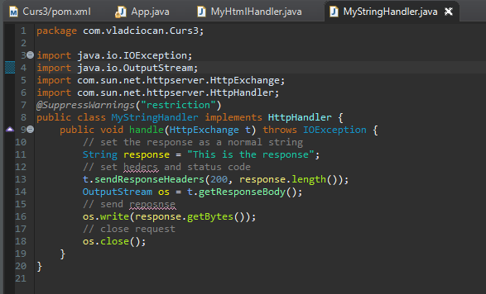
Create a MyStringHandler class

Slide 28
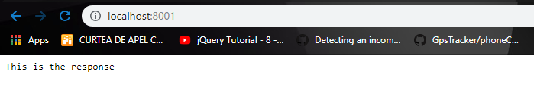
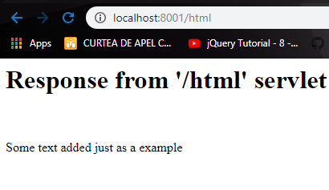
Run the app and check the API`s

Slide 29
That`s it for today
Session review
-You learned about requests
-You know how create a webserver
-You know how to map servelts
-You learned how to handle incoming requests
GOOD JOB! ☺

